Slide 1
Building Support
Partial Response

Slide 2
Partial Response
Learning Objectives:
Why send partial API response?
Walkthrough examples of API partial response
Notes:
--- by the end of this you should be able to explain what are partial API response, how to design an partial api partial respons
---- (CLICK) the benefit of sending partial api responses
----- (CLICK) we will learn how to implement a partial api response

Slide 3
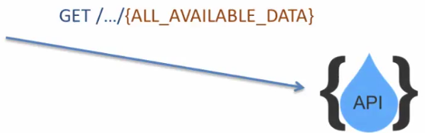
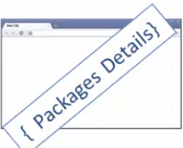
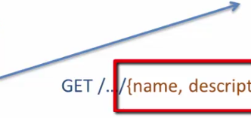
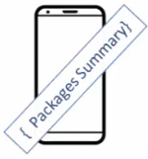

Partial API Response
Notes:
----- An API that supports partial API response put the API consumer in control of the response data that is sent back
----- the API consumer or the application developer in invoking these API can decide what makes sense for their particular application
---- lets consider a travel portal that support partial API responses
----- (CLICK) if there is an application developer who is building a web based application with a browser front end, they would like to show all the package details on the browser page since there is enough page landscape to display all the information
------- (CLICK) they can simply invoke the GET vacation packages and the API will return ALL the available data
----- (CLICK) if the same API needs to be invoked by a mobile application
----- the developer may not want to display all the data, because of the screen size limitation, they may want to only show some information from the response
----- one way they would do it is to call the same API used to create a response used by the browser
----(CLICK) if the vacation API response supported partial API, the mobile app developer would be able to specify the particular fields they would like to receive in the response

Slide 4
Benefits
Better performance & optimized resource usage
CPU, Memory, Bandwidth
Common API version for all consumers
To support multiple devices, user cases – form factors
Notes:
----- lets go over the benefits of supporting partial response in your API
------ (CLICK) The first one is better performance & optimized resources usage
------- the idea here is that if a large response is received by an application by the browser front end or by a mobile application, there is a need to parse the data
------ which would require (CLICK) CPU, Memory, and network Bandwidth to processes the parsing of that data
------- so if the application does not require all the fields received in the response data, then all this parsing is useless and can be avoided by way of support for partial responses
---- (CLICK) Common API Version for all consumers, (CLICK) for example, supporting of multiple devices, use cases and form factors, you can simply provide one API version

Slide 5
Specifications
Notes:
---- the API consumer needs to have a way to specify the things they would like to see in the response
---- there are various ways of doing this, I’ll got through some of the popular APIs and show ways of how they are supporting partial API
---- (CLICK) LinkedIn – Linkedin allows the API consumer to provide the fields they would like to see returned in the response after the resource;
----- so here in this case; it’s “PEOPLE” that is the resource and ID, First-Name, Last-Name are the comma separated fields that the response will return
----- (CLICK) Facebook uses the query parameter called Field and the Fields are a common separated list
---- (CLICK) Pin-ter-est – also uses the same mechanism as Facebook; using a query parameter fields equal to an then a comma delimited separated fields that the response will return

Slide 6
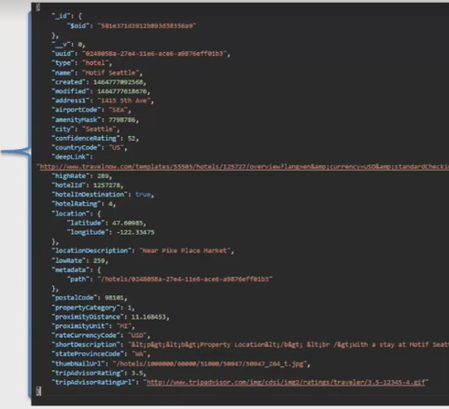


Project #1
Notes:
---- I will walk you through the implementation of a partial response model for a pretend company called ACME
---- (CLICK) ACME is establishing a partnership with multiple portals around the world and their database of portals is growing
---- the designers of ACME have decided to exposes these portals by way of an API (CLICK) resource
---- each of their portals have some data; which is quite big and since this API will be used for mobile applications as well as browser front ends
They would like to give the control to the API consumer or the app developer to decide what fields they would like to receive
----- (CLICK) and the mechanics for specifying the fields in the request will be the query parameter fields equal to the comma delimited fields that the consumer of the API would like to receive
------ So lets go with the code for implementing this API

Slide 7
Solution
Gethub
https://gethub.com/acloudfan/REST-API_Course.get
Branch partialresponse
Git clone –b partialresponse https://gitub.com/acloudfan/REST-API-Course.git
npm install
Notes:
--- the code that I am going to walk you through is available on git hub
--- under the branch partial response
--- please go ahead and clone it on your local file system
--- we will go through the code in order to develop a practical understanding of it’s make up

Slide 8
MLab
Step 1: Go to mongolab.com
Step 2: Create your free mlab account
Step 3: Create a database subscription
Step 4: Connection to your new database using mongo shell
Notes:
Step 1:
Step 2: To get started with mLab, you must first create your free mLab account. When that’s complete, you can add as many database subscriptions as you want.
Step 3: In a terminal window, connect to your database using the mongo shell (the command will look similar to the following example):
Example: mongo ds012345.mlab.com:56789/dbname -u dbuser -p dbpassword,,,, You can grab your connection info after logging into your account and navigating to the database’s home page:
was a first step we will create a new collection name under the

